Slide 1
How to Design your own High Adventure Trips
(and why you want to do that)
Presenter – Ted McLaughlin, Scoutmaster Troop 33

Slide 2
Why am I doing this class?
Because I want to have more Troops/Crews have the kind of adventures that my Troop has
Having Trips like these makes your Troop stronger
The more strong Troops out there the better Scouting will be overall
I’ve done 20 of these Trips, and I believe I can convince more Troops that they aren’t that hard to do, and that they can be done safely
I believe that your average summer camp does not offer enough “adventure”
Many Scouts have told me over the years that these Trips are why they stayed in Scouting

Slide 3
What is a “High Adventure” Trip?
Wikipedia describes it as:
“High adventure is a type of outdoor experience. It typically is meant to include activities like backpacking, hiking, kayaking or canoeing. It may also includemountaineering, rock climbing, mountain biking, orienteering, hang gliding, paragliding and hot air ballooning.”
For most in the BSA it implies going to one of the big National HA bases such as Philmont

Slide 4
What does “Roll your Own” mean?
A long term trip to a non-BSA location. This could be a State Park, a National Park, a bike trail, a river, or another country
Your Troop/Crew plans it without having a lot of hand holding from another organization
A way to do exactly what your Troop/Crew wants to do, and to not select from pre-defined activities

Slide 5
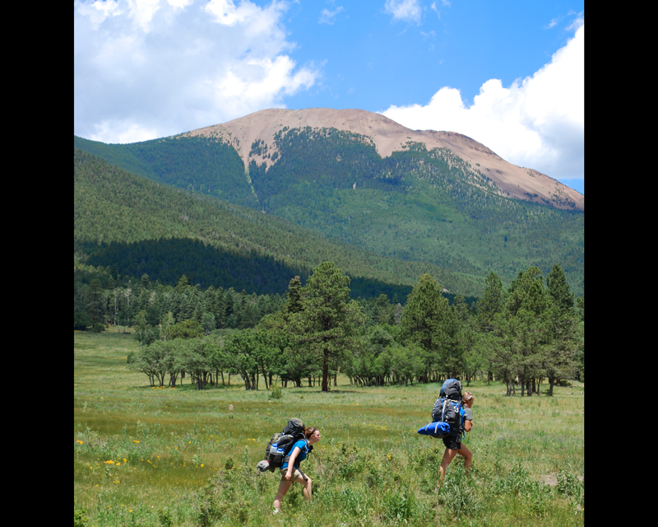
Standard BSA High Adventure Trips
Philmont
Seabase
Northern Tier
Summit
Calvacade
??

Slide 6
Costs of Standard HA Trips?
Philmont - $522 (plus transportation)
Seabase – $1,150 (roughly based on crew size, plus transportation)
Northern Tier – $100 per person per night, (roughly, plus transportation)
Calvacade – $780 (plus transportation)

Slide 7
Other issues with standard BSA High Adventure Trips?
Only allowed for Scouts 14 and over, (with some exceptions)
Locations hard/expensive to get to
Lottery to get selected
Long lead times
Group size limits
A few other rules from National that might be a little annoying

Slide 8
What are the benefits of planning your own High Adventure Trip
Cost savings!
Your Troop/Crew decides where they are going and what they are going to do
You can find VERY cool places to go that are much closer to home
You don’t do the same HA Trip every time
Scouts get MUCH more experience by having to plan their own trip. When there is no hand holding from National bases your Scouts HAVE to learn how to do all of this
Less issues with group size limits
Take younger Scouts
In many cases you are not “locked in”, you can cancel reservations or go with less scouts with no penalty
Freedom from a whole bunch of rules

Slide 9
My Troop’s HA Trips
1999 – Amtrak to DC
2000 – Houseboat Trip
2001 – Black Hills
2002 – Glacier NP
2003 – Canoe Crow Wing River
2004 – Flew to DC
2005 – North Shore
2006 – Canoe 108 miles down Missouri River in MT
2007 – Glacier NP
2008 – Kayak Apostle Islands/Canoe St Croix
2009 – Black Hills
2010 – North Shore
2011 – Canoe Crow Wing River – (fallback plan)
2012 – Road trip across UP
2013 – Glacier NP
2014 – Canoe/Backpack in AR/MO
2015 – Black Hills
2016 – Biking Munger Trail
2017 – Road Trip across UP
2018 – Epic 2 week Trip to DC and NYC for 100th anniversary of the Troop
2019 – Glacier NP

Slide 10
Some notes about our Trips:
ALL Scouts are welcome – no age minimum
We (normally) limit out of pocket to no more than $400 per trip, they are usually a LOT less than that. Normal is $150-$200
Our Troop subsidizes costs based on Troop revenues from fundraisers, usually $100 per person
We generally have no limits on the number of Scouts who can go, as long as they register in advance. The most we have had is 40 Scouts
These trips are over and above our summer camp weeks

Slide 11
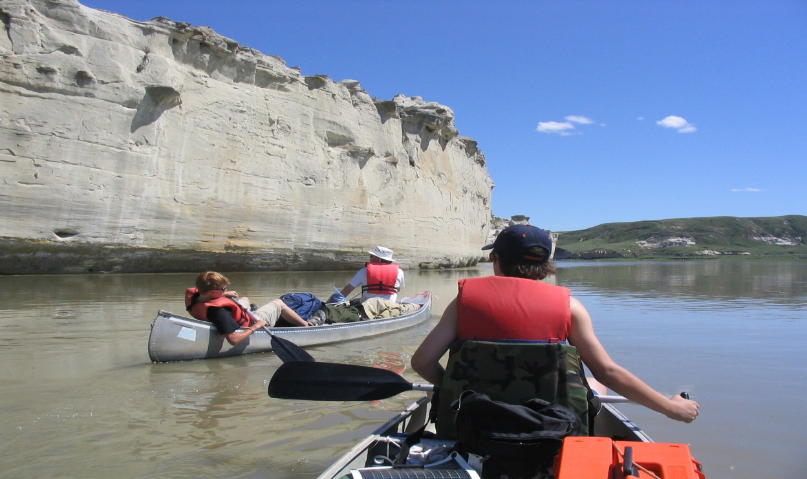
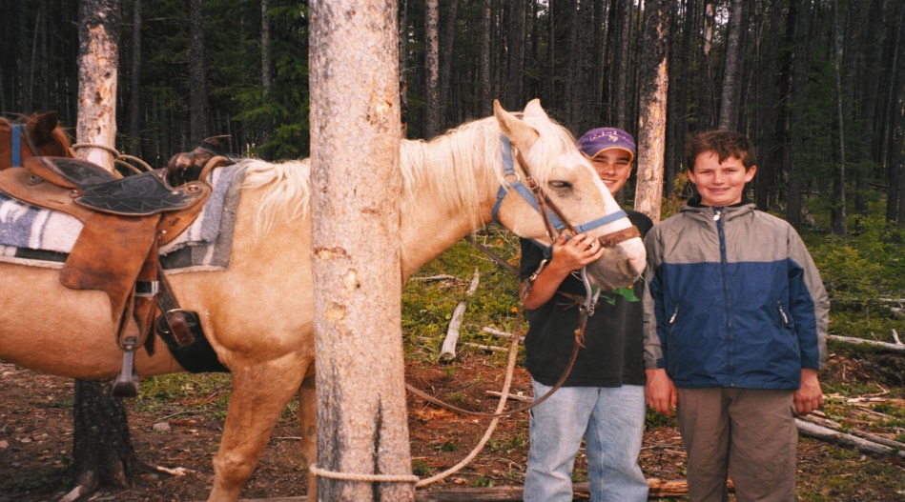
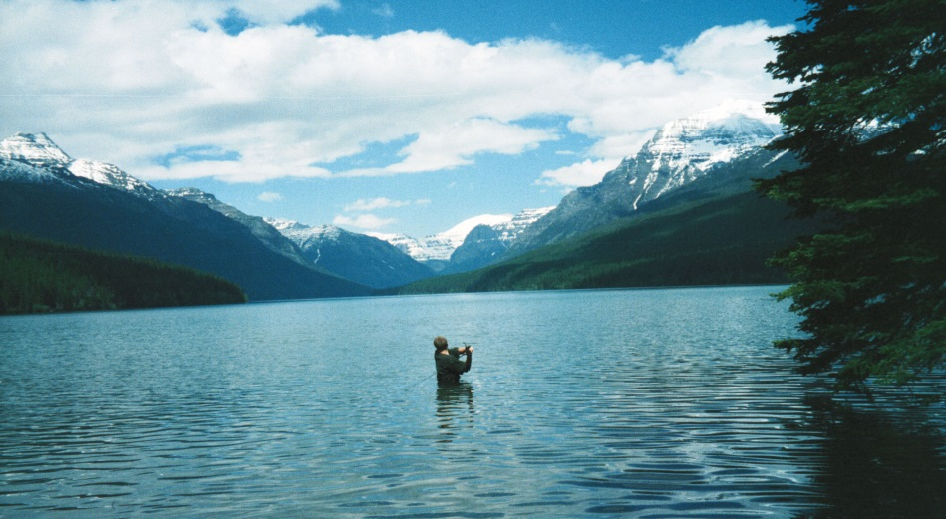
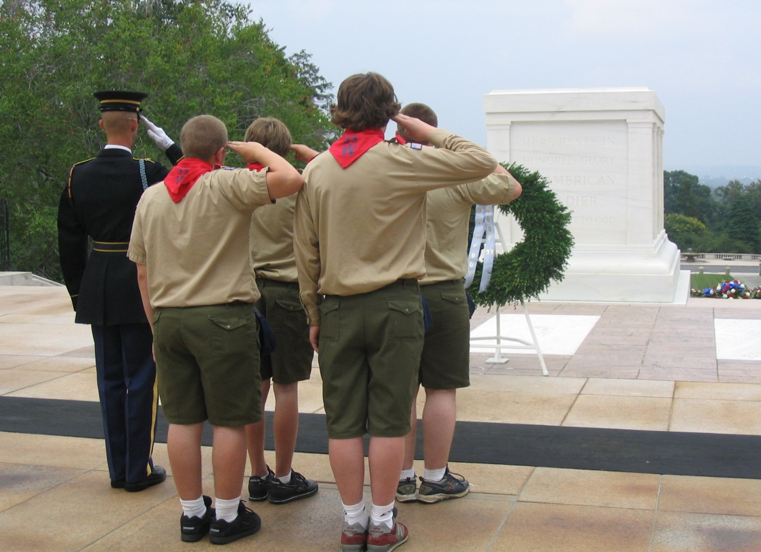
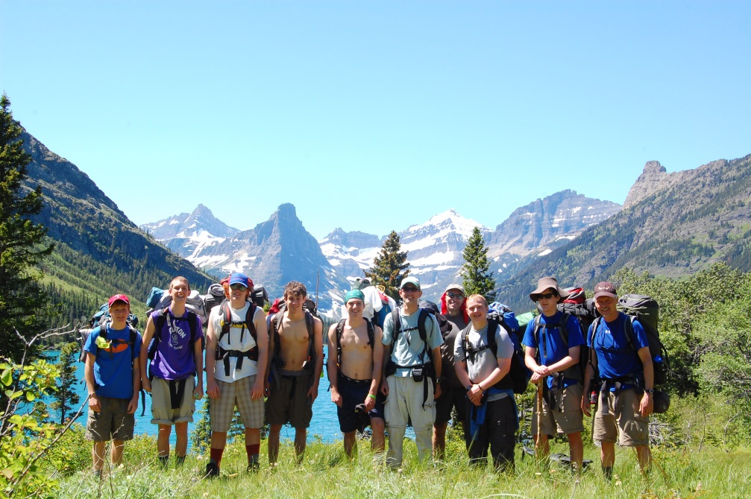

Slide 12
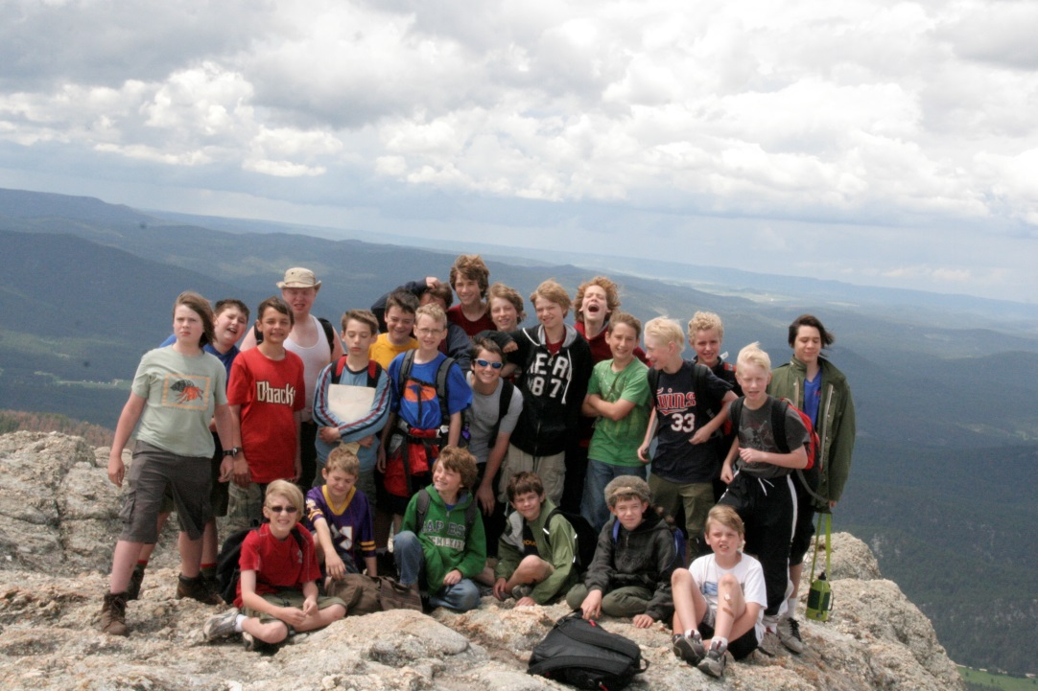
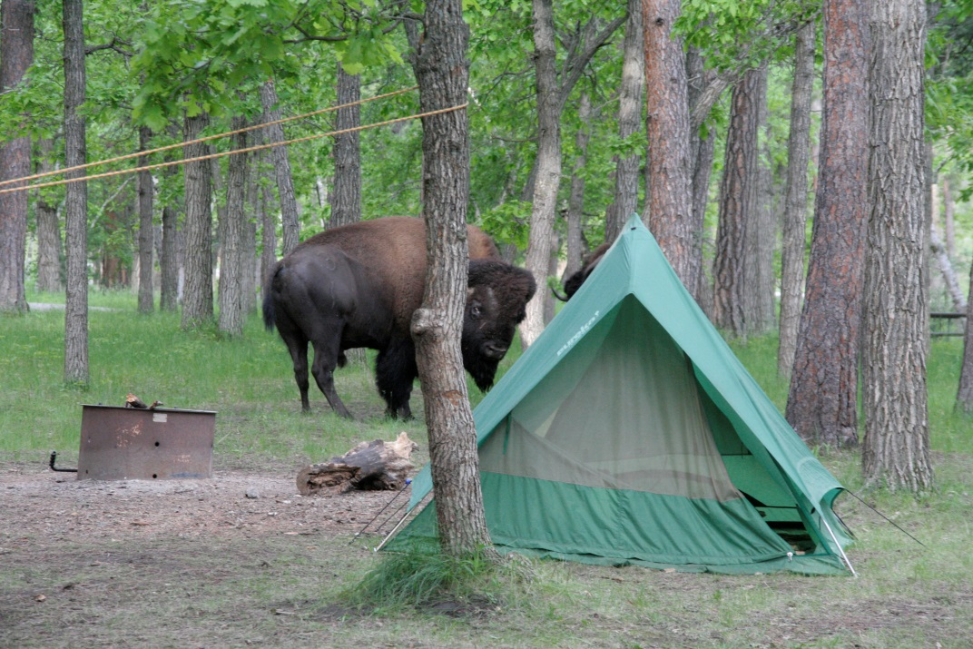
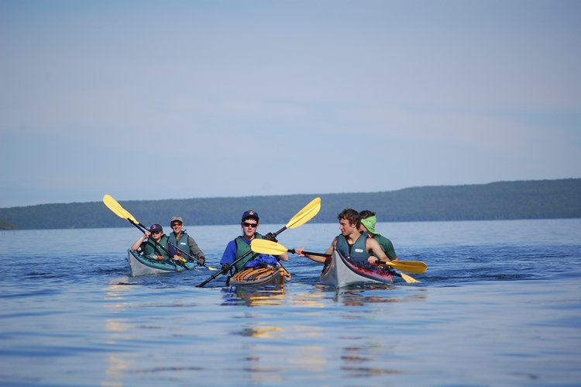
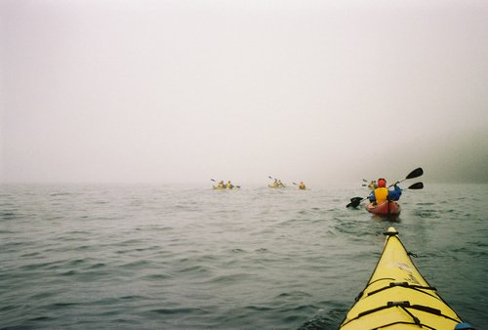

Slide 13
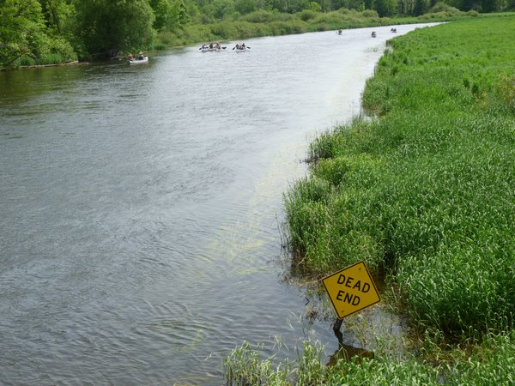
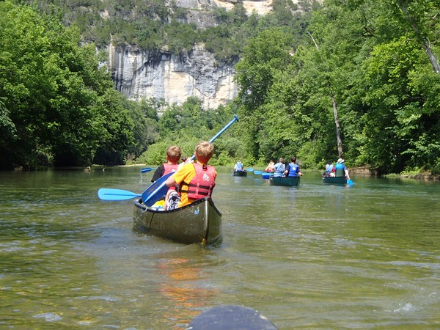
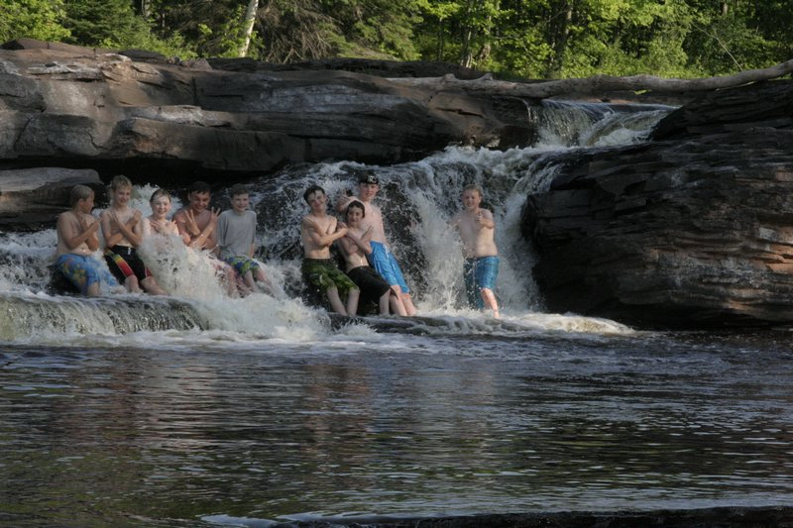
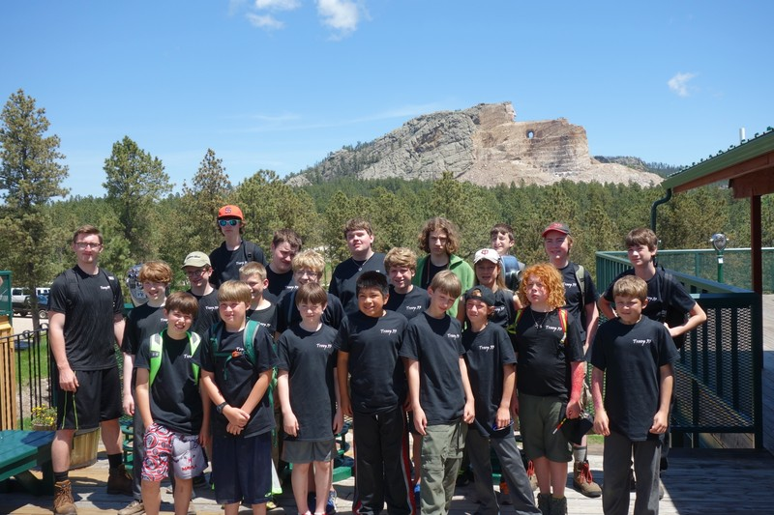

Slide 14
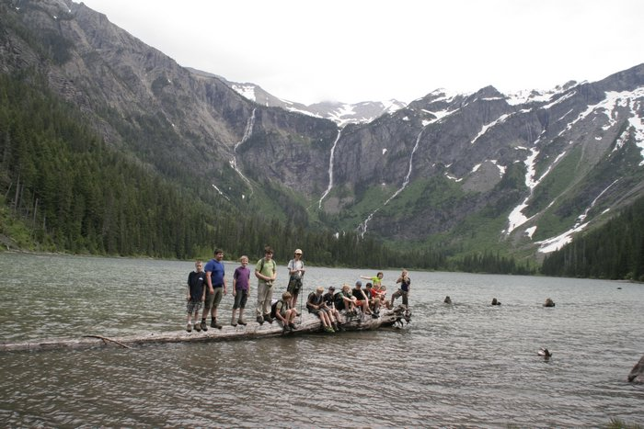

Slide 15
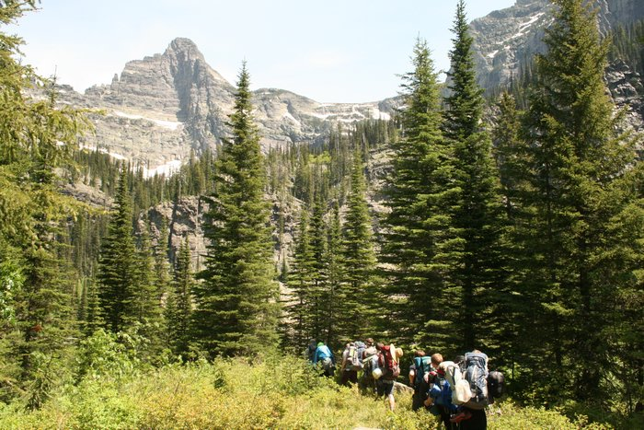

Slide 17
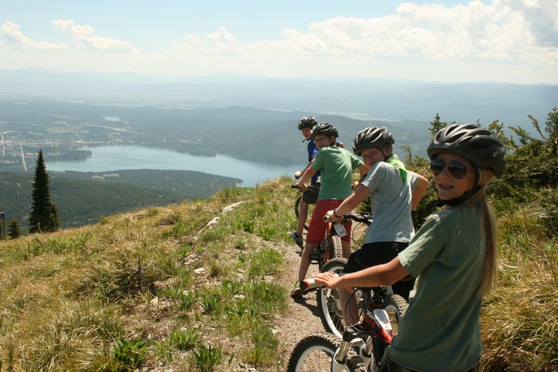

Slide 18
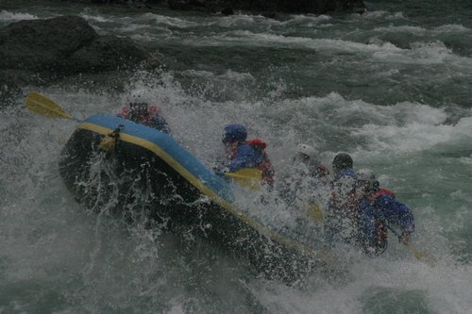

Slide 19
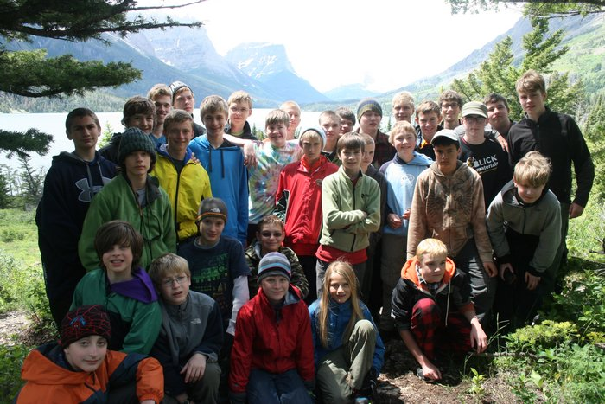

Slide 20
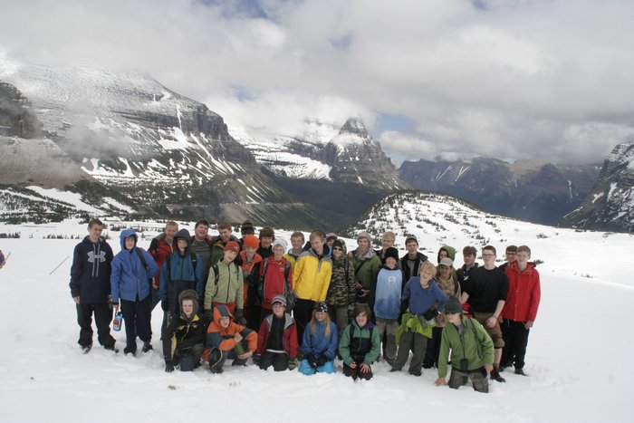

Slide 21
How to start this in your unit
Be confident you can do it, (you really can)
Sell the idea to your PLC. Get them excited by showing them pictures of other Troops doing these kinds of Trips
Sell your Troop Committee by doing the same thing at their meetings
Come up with a few ideas to plant a seed with your PLC. Give them a few easy options to plan and then let them run with it

Slide 22
Some things to think about
Get your ideas for the Trip from the Scouts. Don’t just go where the adults want to go, or where you have always gone in the past
Figure out the dates of your Trip as FAR in advance as possible and publish them, even if you don’t know where you are going yet
Check and double check reservations, especially if you are going far away
Have a loose Plan B, (and C), in case something unexpectedly comes up

Slide 23
More things to think about
Consider splitting up the Troop – more strenuous activities for older Scouts, less for younger
Not everyone wants to backpack for a solid week, do multiple things on your Trip
Don’t over schedule – have free time to just play games
Have Trip T-shirts made up. Make the Scouts design them. Have special t-shirt made for planners

Slide 24
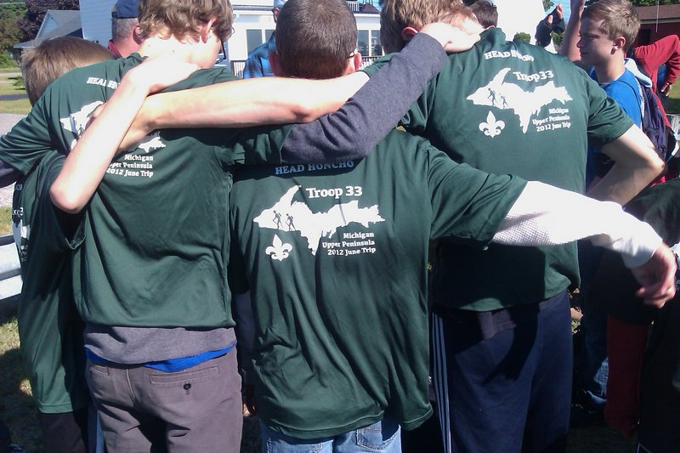

Slide 25
Think outside the box
When our last Glacier Trip was coming in over budget we had 6 adults drive out to MT in 2 minivans. That saved us 6 adult tickets on Amtrak, and it saved us a 15 passenger van rental. That FAR outweighed the price of gas for 2 minivans to get to MT.
Amtrak food isn’t cheap, (but it is good), so we had pizza delivered to the train as we went through a small town in ND.
On another Trip at a long train stop we had a couple adults run to a nearby grocery store and buy box lunches that had been pre-ordered

Slide 26
Make the Scouts plan this
Scouting is YOUTH RUN, don’t let well meaning adults take over
The youth CAN plan these Trips, they just might need some assistance and encouragement
Keep the planning committee small. No more than 5 or 6 Scouts or the meetings get out of control
The Scouts will work a LOT harder planning this if they were the ones who chose the destination
Have a couple younger Scouts on the planning committee, they will be the ones planning future Trips. Within a couple years your Troop will be planning these with no problems
Have the planning committee actually be in charge during the Trip. When surprises happen make them figure out what to do about it

Slide 27
How to pay for the Trip?
My Troop only has one fundraiser a year
Every Scout who meets his goals get’s $100 in their Scout account to use for this or summer camp
Troop will subsidize usually $100 per Scout per year, as long as Troop’s goals were met
You may need to hold multiple fundraisers, depending on what you are planning
Plan a long ways out to give your families time to save money for this
Have deposits due well in advance, and then final payments as you get close to deadlines, (i.e. your final payment to the airline is due)

Slide 28
Your Adult Chaperones
Get them lined up early
Make sure you have at least one extra, in case one drops out at the last minute. That one extra adult is handy in case a driver gets sick or just tired and you need to swap drivers
If you are in cars it’s hard to have enough adults for 2 per car, but it’s a nice thing if you can have at least a couple extra, (though you still shouldn’t drive more than 10 hours per day)
Make sure that they are good with lots of Scouts and longer trips. Finding that one of your adults isn’t working out is NOT good when you are a long ways from home, (been there, done that)
Have solid rules for the adults as well as youth
http://www.troop33.net/misc/parent_guidelines_for_camping_33.html
Adults do same pre-trip trial runs as youth. Don’t just trust an adult who says “I have lots of experience canoeing”, make them show it to you on shake down trips
Find adults with the right skills – if you are backpacking in the deep back woods, have experienced leaders for that

Slide 29
Post Trip ideas
Learn from your Trip – Try to have every adult and Jr Leader write up a debrief about what worked good and bad, and what should be done differently next time
Analyze your finances – Track and break down every expense to determine how close you were on budgeting every item.
These two tips will be invaluable the next time you do this specific Trip again
Post lots of pictures – get Scouts excited to do another Trip the following year! Plus these pictures are remarkable recruiting material. We’ve had MANY Scouts join our Troop just because of these pictures
On the last night of our Trips we have a final campfire, during which each Scout lists what their favorite memory was, what they learned, and where they want to go next year

Slide 30
Questions?

Slide 31
I hope you learned something!
For more information feel free to email me at ted.mclaughlin@gmail.com

Slide 32
Addendums (more detailed info)
How we plan our Trips – 4 pages
Food – 2 pages
Using the internet to plan – 1 page
Transportation – 3 pages
Medical – 2 pages
Budgeting – 3 pages
Sample itineraries – 1 page
Be Prepared – 1 page
Other resources – 1 page

Slide 33
How we plan our Trips
Late September - Date for next year’s Trip is picked and published to all families in the Troop
Early October – Scouts get together to start brainstorming. Start with a couple dozen ideas, narrow it down to 3 or 4
Mid-October – Each idea has a Scout “Sponsor”, who has to sell that idea to the rest of the Jr Leaders however they can. The Sponsor also has to come up with a ‘rough’ itinerary.
Late October – Vote is taken, and planning committee formed. SPL and Sponsor are always on that Committee.

Slide 34
How we plan our Trips
Early Nov – Idea and rough budget presented to Troop Cmte for their approval. This is also where we find out how much money the Troop will subsidize the Trip, (wreath sales are done)
Mid-Late Nov – Planning Cmte solicits ideas from Scouts/Adults and fills out the itinerary
Dec/Jan – Planning Cmte presents plan to the Troop Court of Honor. This is to start getting Scouts excited about it, and give parents a chance to start planning for it, (i.e. planning around it)

Slide 35
How we plan our Trips
Jan – March – Depending on where we are going, and how we are getting there, any place that requires reservations is identified and reservations confirmed, (especially air or train tickets). Dates of required payments figured out, which determines when final payments from Scouts will be due. Initial down payments from Scouts are due
April – May – The nitty gritty details are worked out by planning committee. Final payments are made from Scouts going

Slide 36
How we plan our Trips
April – May – Shake down backpacking campouts or canoe trips, as well as weekly meetings devoted to prep work if necessary
May – Final gear lists, (Scout, Patrol, Troop), are finalized and checked
Late May – Early June – Non-perishable foods purchased in bulk
Early June – Food sorted by patrol/date and packed according to plan. Backpacking trips handled a little different
Right before Trip – perishables purchased if necessary depending on Trip. All personal and Troop gear is loaded into the Troop trailer a week in advance of departure. That makes the departure go MUCH smoother
(the above plan works good for US based trips. Overseas trips will require more long term planning)

Slide 37
Food – It’s VERY important
Ask the Scouts what they want to eat – have a survey for each meal type, (i.e. breakfast, lunch, dinner)
Buy early, look for sales
Buy in bulk at Sam’s Club, then split it into Patrol servings. We normally do lunch as a Troop, but breakfast and dinner are cooked by patrols
Buy non-perishables at home early, then buy perishables right before you leave. Then do a food run during the Trip to restock
Plan for snacks and good desserts. On a long trip the Scouts will get tired without enough food, and it’s better to buy a little extra
End on a bang! – Eat out somewhere nice for your last meal of the Trip

Slide 38
More Food thoughts
Have a separate box for food that you will eat on the way there/back. PBJ, apples, cookies etc that are easy to eat a rest stop. This should be right by the door in your Troop trailer for easy access
It’s cheaper to buy food at grocery store along the way than to hit fast food, you just have to make sure there is a bathroom somewhere when you are eating it
If you have a big group, not every small town grocery store will have enough of what you need

Slide 39
The internet is your friend
Planning your route with Google Maps makes this process SO much easier
You can find every rest area in the upper midwest, which makes route planning easier
Google Street View can show you things you might not expect, (like a rest area that doesn’t actually have any bathrooms)
Checking every state’s DOT road construction maps before you leave home
Find Troops where you are going and contact them. Find out what they do in their area

Slide 40
Transportation
Planes, trains, and automobiles – All have their place in your plans
Planes – are fast but expensive
Trains – a little less expensive than planes, but faster than vehicles. Scouts love to travel by train, but expect delays
Charter bus – We’ve discussed this option, but never used it, so I can’t say much about it.
15 passenger van rentals – An option that can help when you can’t find enough seatbelts, or adults willing to use their vehicles. One big concern is that 15 passenger vehicles are rated as the most dangerous vehicles in the world to drive
Mini-vans & cars – slow, but cheap. Note that there IS a cost to time. If you have 8 days total for your Trip, do you want to spend 4 days of that on the road going there and coming home?

Slide 41
More Transportation
G2SS says no convoying – But we do it every trip. It makes it much easier to handle food while driving long distances
Slowest vehicle sets the speed – Usually this is the one towing your trailer if you have one
Try to have more than one trailer hitch, just in case
Leave at 8:00am – drive for 2 hours, take .5 hour break. Drive 1.5 hours, eat 1 hour lunch. Drive 2 hours, have a .5 hour break, drive 2 hours, have 1 hour dinner. Drive 2 hours, camp for the night. This gives drivers a chance to unwind, and Scouts a chance to blow off energy playing games
Don’t be afraid to “camp” at a church or military barracks along the way to save the time spent setting up and taking down tents
Don’t try to go more than 2 hours without a planned stop. Otherwise you will almost assuredly have to stop when some Scout has to pee
BSA limits driving to 10 hours of actual driving. That’s a good limit. You do NOT want drivers falling asleep at the wheel
If you are driving in mountains, or even just long steep hills, make sure your drivers understand about downshifting. This is critical with a van load of kids and gear, especially if it has a trailer. Too many people think that only applies to semi-trucks. It also applies to mini-vans as well!

Slide 42
Still more transportation
Record gas purchases for every vehicle every time you put gas in them
Try to have a little wiggle room on # of seatbelts so when a car breaks down the whole Troop isn’t stuck.
Strongly suggest to adults that they get tune-ups/maintenance done on their vehicles before the Trip
Have every vehicle have an extra set of keys that is stored in a different vehicle
Have the Scouts navigate in the vehicles – it’s a great learning opportunity
Have every vehicle have a copy of Google maps for every day, showing every stop and so on. Make the Scouts read them and tell the driver what to do
Have every driver’s cell phone numbers, and any other numbers you can get, in each vehicle. This is very handy when someone gets lost or breaks down
Communications can be a problem in remote areas – plan for cell phone loss. Also try apps such as “Find My Friends” or Waze to help
Know in advance who is riding in which vehicle. Keep patrols together if possible.
Every driver should KNOW who is in their vehicle
At every stop the SPL should double check to make sure every Scout is back in the vehicle that they are supposed to be in

Slide 43
Medical Stuff
Get medical forms/issues figured out well in advance.
Make sure Scouts (and adults) are physically fit enough to do the things that you want to do
Have shakedown weekends in advance to make sure
Try to find a medical type person to go along with you if at all possible
If your Troop/crew is splitting up, make sure that there are first aid kits with all groups
The same thing for medical forms, make sure if the group splits up that a COPY of each Scout’s medical form goes with them
Know the location of every ER/Clinic anywhere close to where you are going. This has proven VERY valuable in the past. Google maps is great for planning these in advance

Slide 44
More Medical
Bring extra meds, especially for the critical ones. Don’t let one swamped canoe lose all of them
These kinds of Trips can be much more stressful than a weekend campout or a week at summer camp. Make sure you think of any medical issues from that perspective, especially for scouts with emotional conditions
Homesickness can be more of a problem on these kinds of trips than summer camp, (even for older Scouts), be prepared to deal with it

Slide 45
Budgeting
Be generous with your expected expenses, (as in plan higher than you expect them to be)
Plan in a contingency amount because something unexpected WILL come up
I budget $8 for food per person per day, and that is usually more than we spend
Budget for adults for caffeine. Seriously. On a long trip it’s better to budget $50 or $75 than to have an adult fall asleep at the wheel
For most of our trips we don’t charge the adults. We figure if they are donating a week of vacation, plus wear and tear on their vehicle, the other parents can pay for their Trip. The only time we charge adults is when we have plane/train type tickets
Prepay as much as possible – it’s easier on the trip leader’s credit cards if half the stuff is already paid for

Slide 46
Budgeting things to remember
Don’t forget tolls/fees - bridges, toll roads, state park camping fees, etc add up quickly
Tips for guides – most guides don’t make a lot of money, as Scouts we should tip them
Propane/white gas/etc – it adds up over a week
Firewood – it’s not cheap, and don’t even think of trying to bring it from home
Gas – find out the MPG of all vehicles, cut it by 10%, guess the price of gas, add 10%, guess total expected miles, add 10%, then figure out Trip fuel costs
Be aware that some outfitters and such won’t accept credit cards. Find out before you arrive what your payment options will be

Slide 47
 |  |  | Actual income & Expenses vs Budget
 |  |  |  |  |  | Actual |  | Budgeted |  | Difference:
Scout payments |  | $350 | x | 33 | = | 11,550.00 |  | 11,550.00
Adult payments |  | $350 | x | 11 | = | 3,850.00 |  | 3,850.00
 |  | Particpant Income |  | 44 |  | 15,400.00 |  | 15,400.00
Troop Subsidy |  | $150 | x | 44 | = |  |  | 6,600.00
 |  | Total Income |  |  |  | 15,400.00 |  | 22,000.00
Amtrak |  |  |  |  |  | 7,869.00 |  | 7,854.00 |  | 15.00 | (positives are bad here)
15 Pass Van rental |  |  |  |  |  | 2,470.54 |  | 2,470.54 |  | 0.00
Van Gas |  |  |  |  |  | 1,533.62 |  | 250.00 |  | 1,283.62
Whitewater Rafting |  |  |  |  |  | 1,909.20 |  | 1,720.00 |  | 189.20
Whitewater pictures |  |  |  |  |  | 0.00 |  | 60.00 |  | -60.00
Horseback riding for 2 Scouts & 1 adult |  |  |  |  |  | 105.00 |  | 0.00 |  | 105.00
Tips for guides |  |  |  |  |  | 120.00 |  | 150.00 |  | -30.00
Moutain Biking |  |  |  |  |  | 1,701.00 |  | 1,580.00 |  | 121.00
Lift Tickets |  |  |  |  |  | 378.00 |  | 382.00 |  | -4.00
Food - Groceries |  |  |  |  |  | 2,147.04 |  | 3,225.00 |  | -1,077.96
Train Food |  |  |  |  |  | 525.46 |  | 720.00 |  | -194.54
Food - Eat out |  |  |  |  |  | 0.00 |  | 344.00 |  | -344.00
Huckleberry shakes |  |  |  | in with the food reciepts |  |  |  | 107.50 |  | -107.50
Min-Van Food |  |  |  |  |  | 88.38 |  |  |  | 88.38
Misc |  |  |  |  |  | 1,148.34 |  | 1,000.00 |  | 148.34
Camping Fees |  |  |  |  |  | 616.51 |  | 598.67 |  | 17.84
Back Country Camping fees |  |  |  |  |  | 19.25 |  | 520.00 |  | -500.75
Post Cards & Mailing |  |  |  |  | In with Misc |  |  | 75.00 |  | -75.00
t-shirts |  |  |  |  |  | 476.50 |  | 400.00 |  | 76.50
 |  |  |  | Expenses |  | 21,107.84 |  | 21,456.71 |  | -348.87
 |  |  |  | Difference: |  | -5,707.84
 |  |  |  | Donated Expenses: |  | 277.44 |  |  |  |  | (not all donations have been added)
 |  |  |  | Total Troop Expenses: |  | -$5,430.40 |  | $6,600.00 |  | $1,169.60 | (positive is a good thing here)
 |  |  |  | Subsidy per person: |  | -$129.72 |  | $150.00 |  | $20.28 | (positive is a good thing here)

Slide 48
Sample itineraries
 |  | Hrs Driving | Morning | Lunch | Afternoon | Dinner | Evening
14-Jun | Saturday | 10.0 | Start driving | at rest stop | Continue driving to Branson, MO
15-Jun | Sunday | 1.0 | Drive to Ponca, AR |  | Start Canoeing/Backpacking
16-Jun | Monday |  | Canoe/Backpack |  | Canoe/Backpack
17-Jun | Tuesday |  | Canoe/Backpack |  | End Canoe/Backpack
18-Jun | Wednesday | 0.5 | Drive to Camp Sunnen | Sunnen | Go Caving |  | Have Showers
19-Jun | Thursday | 4.5 | Drop trailer at Beaumont, then head to City Museum | At City Museum | City Museum
20-Jun | Friday | 0.5 | Pack up | At Arch Park | Arch | BBQ place | Final Campfire
21-Jun | Saturday | 6.0 | leave for home | West Point, Iowa | Continue driving | Clear Lake, IA? | Arrive home
 |  | 22.5
 | Itinerary for 2016 Bike Trip
 | Morning |  |  | Lunch |  | Afternoon |  | Dinner |  | Evening |  | Miles Biked?
Saturday, June 11, 2016 | Drive to Hinkley, start biking |  |  | On trail |  | Arrive at Generral CC |  | In Camp |  |  |  | 22
Sunday, June 12, 2016 | Do fun stuff |  |  |  |  | Service project?
Monday, June 13, 2016 | Bike to Barnum |  |  |  |  | Arrive at Bear Lake county camp or Barnum City Park? |  |  |  |  |  | 12
Tuesday, June 14, 2016 | Bike to Carlton |  |  |  |  | Arrive at Jay Cooke State Park |  |  |  |  |  | 18
Wednesday, June 15, 2016 | White water rafting?
Thursday, June 16, 2016 | Bike to end of trail, then Park Point |  |  |  |  |  |  |  |  |  |  | 15 | Plus 8 to get to Park Point
Friday, June 17, 2016 | Spent fun day doing stuff at Spirit Mountain?
Saturday, June 18, 2016 | Drive home?

Slide 49
Be Prepared! Some examples of things gone wrong
4 days before getting on train Amtrak tells us that due to flooding the train is not running
Appendicitis in the back woods of SD
2 different Scouts pouring boiling water down their shoes in very inconvenient locations
Brakes overheating and warping on both 15 passenger and mini-van in Glacier National Park due to not down shifting on steep hills
Heavy rain for 4 days straight
A couple vehicle breakdowns
Trains arriving 6 hours late, planes being delayed a similar amount
Vehicles getting lost and not able to find destination
President Reagan dying and his funeral is right in the middle of our Trip to Washington DC – (a ‘little’ extra traffic in DC)
Bus throwing a piston rod in the middle of nowhere on the ND/Canada border
Almost losing a Scout who didn’t get back in the vehicle after a rest break, and the driver didn’t notice it till later
Discovering right before the bike trip that the MS150 is happening on the same day/location as our bike trek, and that Grandma’s Marathon is happening on the day we are supposed to ride through Duluth
Having the one vehicle with a trailer hitch lose it’s brakes in rural Indiana.
This isn’t to make you not want to do these Trips, this is to make you realize that you have to be prepared for anything that could happen.

Slide 50
Other Sources of Info
www.troop33.net/scrapboo.html
(look for June Trip links)
http://highadventure.pickettsmillroundtable.info/home

